Slide 1
The CAIRE framework as a population health solution for an optimized health system
Maureen Perrin, Associate Managing Partner, Population and and Public Health
Valérie Lukac, Associate Managing Partner, Health System Optimization
April 27, 2016

Slide 2



Introduction

Slide 3
Roadmap
 | Challenge: Increasing cost
 | Solution: CAIRE framework
 | Solution Applied: Maternal child example

Slide 4
Challenge

Slide 5
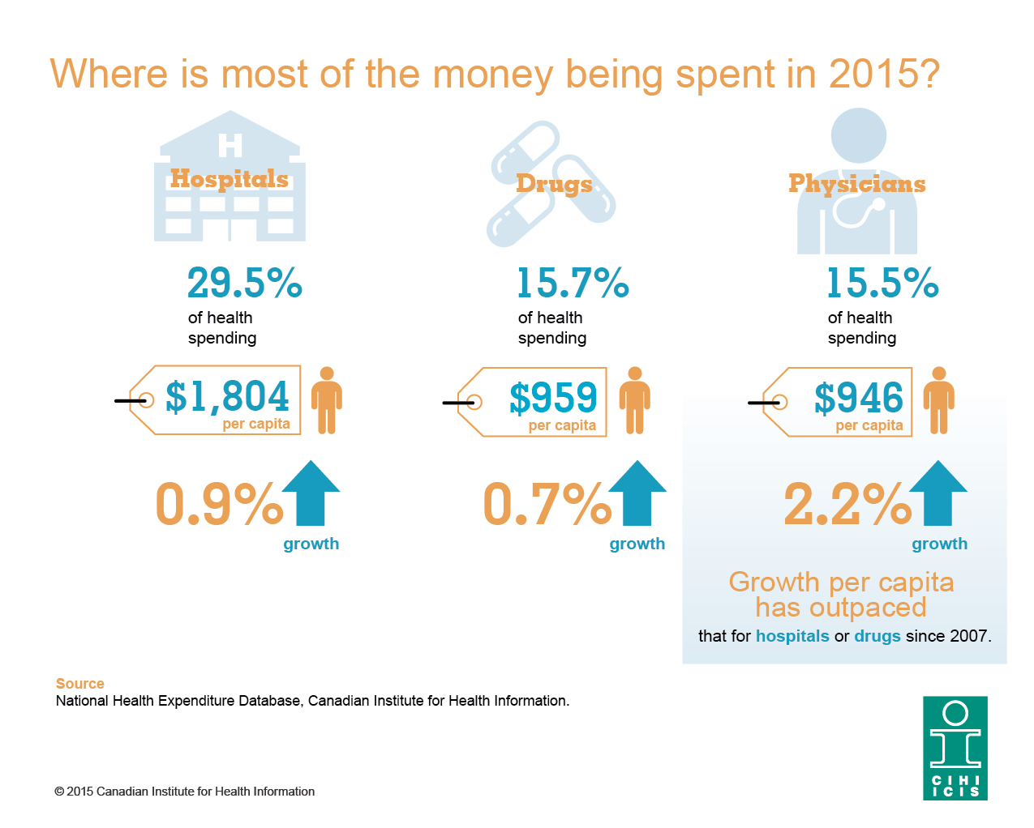
Canadian Healthcare Challenges

Slide 6
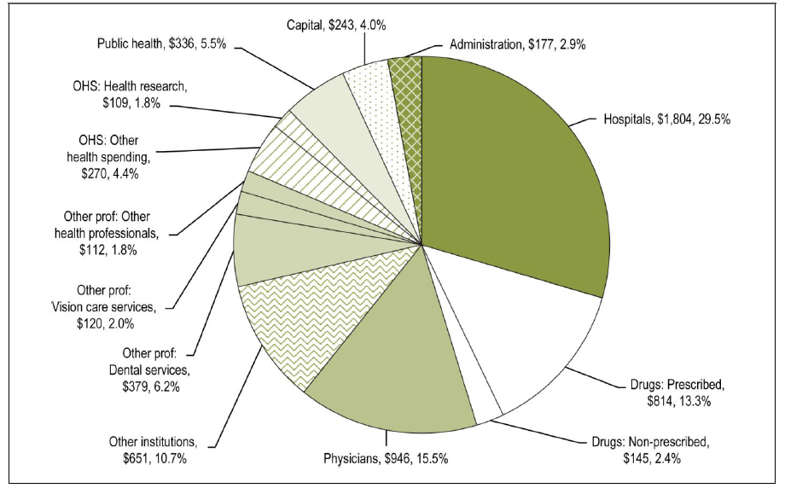
Canadian Healthcare Challenges
Total Health Expenditure per capita by use of funds, Canada 2015 (CIHI)

Slide 7
(Part of) The Solution

Slide 8
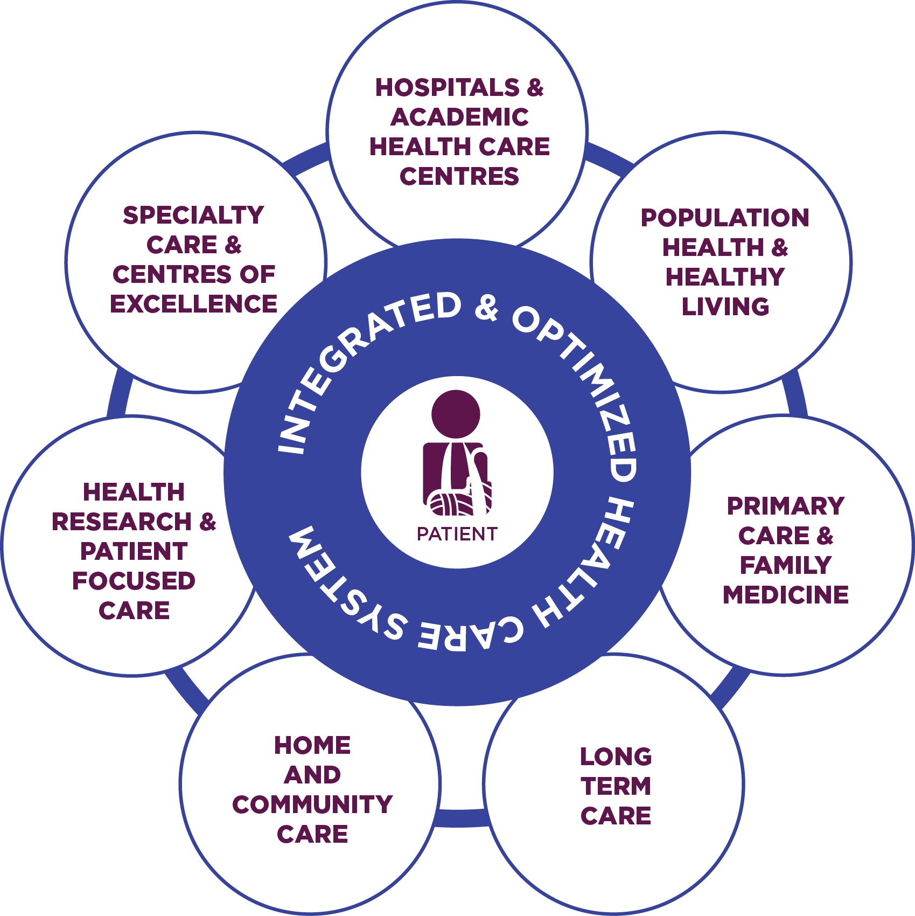
Integrated and Optimized Health System
We envision an integrated and optimized health system that will
maintain or improve the health status of the person

Slide 9
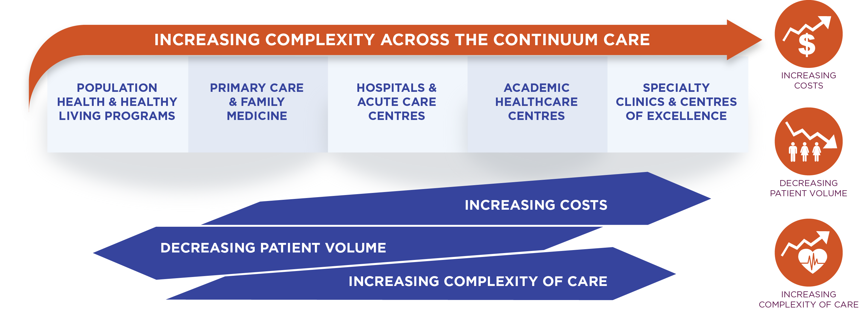
Focused Care
Shifting care to the appropriate setting improves patient outcomes and reduces system burden

Slide 10
Core Principles of CAIRE
To be meaningful, population health solutions demand a minimum baseline of objective, quantifiable data;
To be achievable, population health solutions demand an analysis and interpretation of data in a manner that is sensitive to the organizational context (mission, values, and stakeholders); and,
To be sustainable, population health solutions demand a collaborative and mentor-driven approach to change.

Slide 11
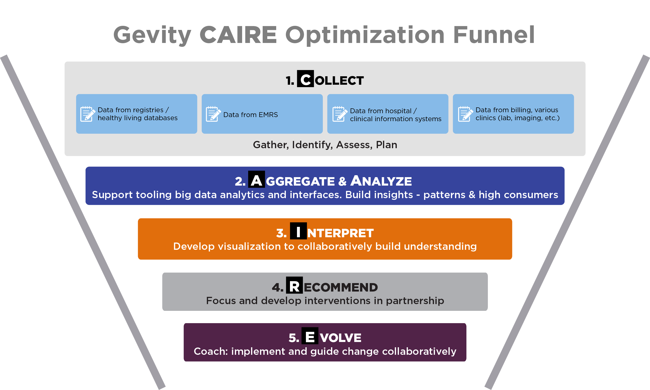
Optimization: CAIRE Funnel

Slide 12
A Case Study
solution applied

Slide 13
Services to Maternal Child Care
Hospital
Hospital
Hospital

Slide 14
Aggregate, Analyse, Interpret

Slide 15
Selected Recommendations & Evolution
Develop case-mix appropriate care strategy
Explore impact of increasing % of patient population with mental health concerns
Manage the resource intensive and high cost users
  Small % of the patient population drives highest costs (NAS, substance abuse, poor social determinants of health)
  Mitigate by continuing and expanding significant work creating strong community support & networks

Slide 16
Challenges
Data and people…
  Assembling data from disparate sources can be resource intensive
  Evolving system requires changing people
Evidence to re-allocate funds upstream is not straightforward

Slide 17
Next Steps
How do we create incentives to deliver care in the right settings, with seamless transitions?
The research, policy, and practice actions that should be taken as a result of our findings include developing a study based on the CAIRE framework solution to compare its impact across provincial boundaries on population health

Slide 18
Thank you

